Slide 1

COLLEGE ACTIVITIES TRACKER
Date: 25 June2021
AFREEN BEGUM : 17WH1A0596
SANIA THAHASEEN : 17WH1A0598
NIHARIKA. V : 18WH8A0501
Internal Guide: Mr. K.NARESH
Designation: Assistant Professor
Department of Computer Science & Engineering
BVRIT HYDERABAD College of Engineering for Women

Slide 2

ABSTRACT
Why Should I Study this course?
College Activity Tracker is an web application that will allow the users ( both faculty and students) to upload their documents and intimating each activity ( hackathon, workshops, competitions) that they participate in and out of the college with certifications as the proof. And it should also allow the user to register for the on going or upcoming events through the form and after registration, A successfully registered message should be send to the user to their corresponding phone number.The faculty must be allowed to check or keep track of students and faculty performance and previews the data year wise, department wise, event wise. And faculty should be allowed to add/update the upcoming event happening in the college.
Examples
BVRIT HYDERABAD College of Engineering for Women

Slide 3
SYSTEM REQUIREMENTS
ENVIRONMENT | SPECIFICATIONS
HARDWARE | Processor - Intel Core i5 Memory(RAM) - 8 GB Storage – I TB
TOOLS AND TECHNOLOGIES | JAVA JDBC, JSP HTML, CSS MYSQL Apache Tomcat Server.
BVRIT HYDERABAD College of Engineering for Women

Slide 4
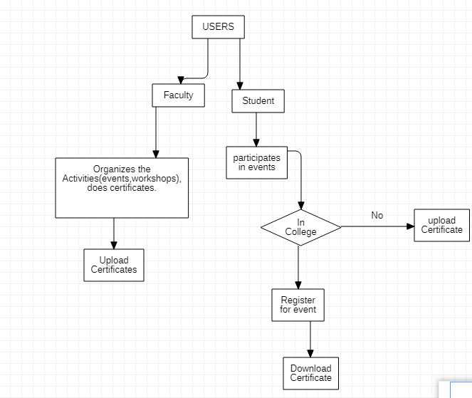
DESIGN

Slide 5
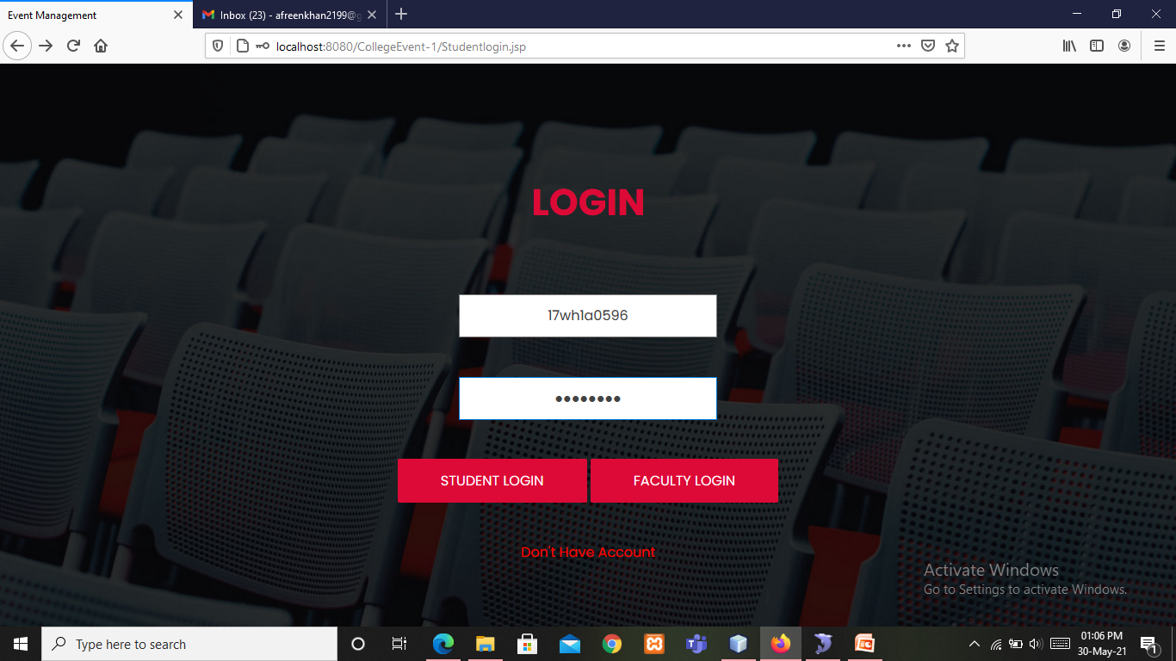
IMPLEMENTATION AND OUTPUT

Slide 6
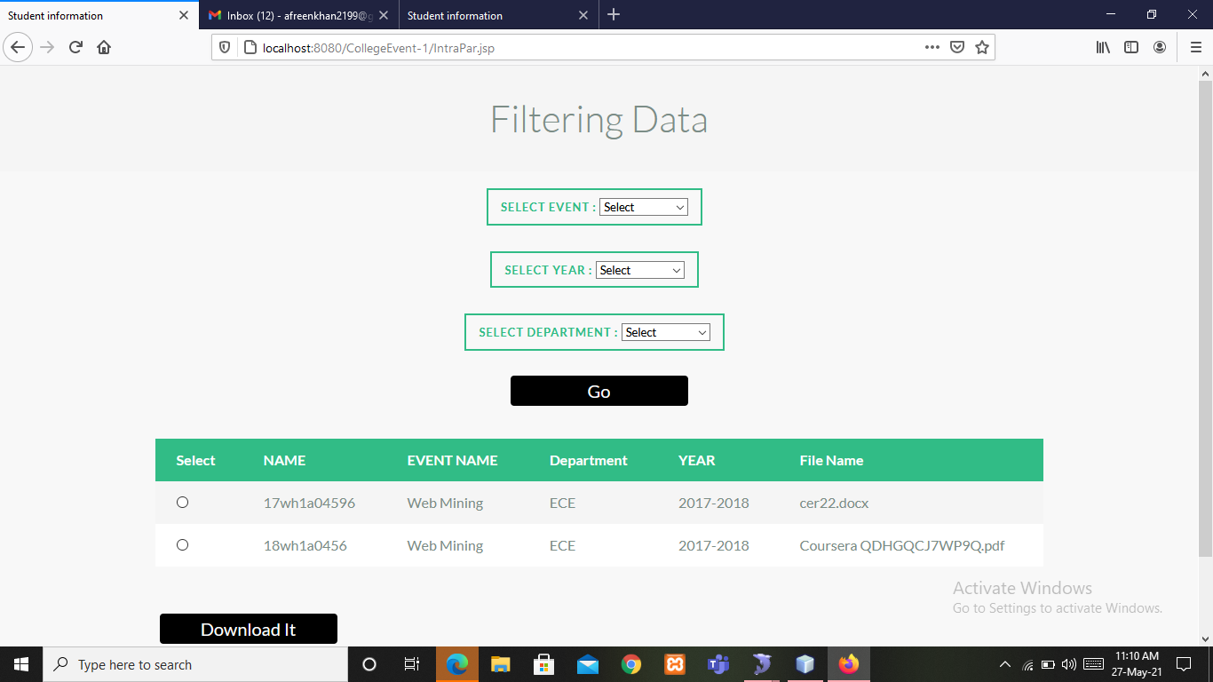

Slide 7
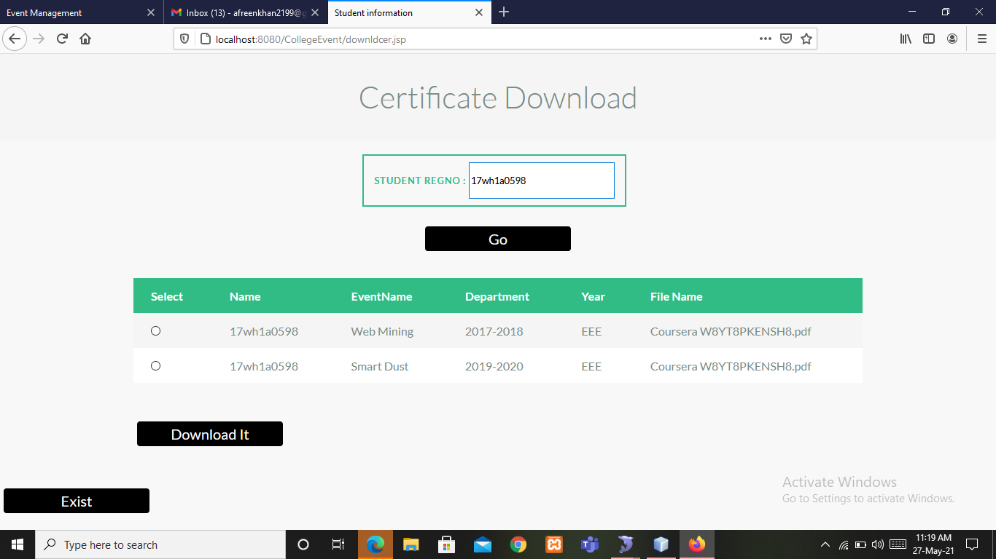

Slide 8
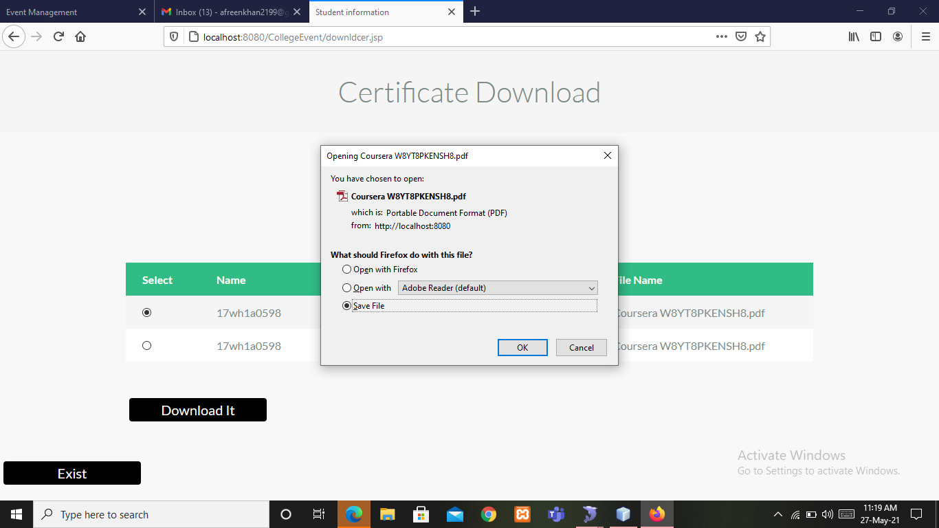

Slide 9
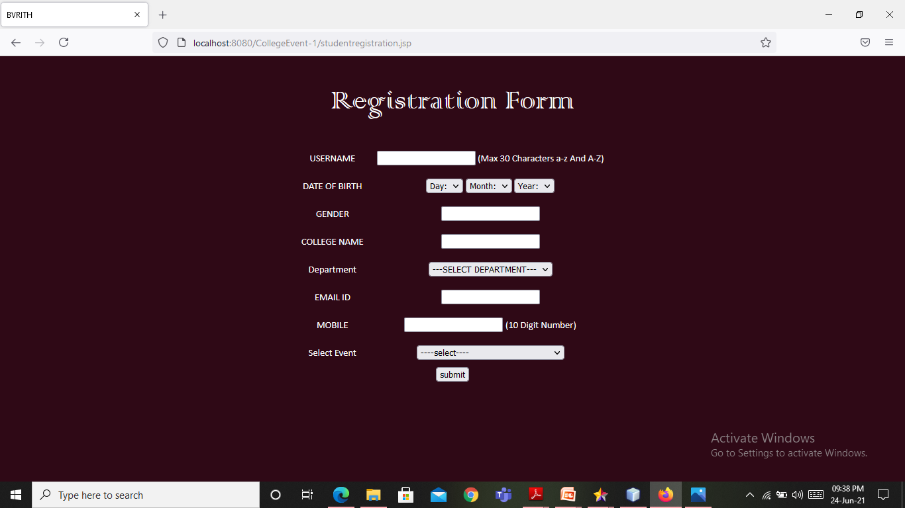

Slide 10
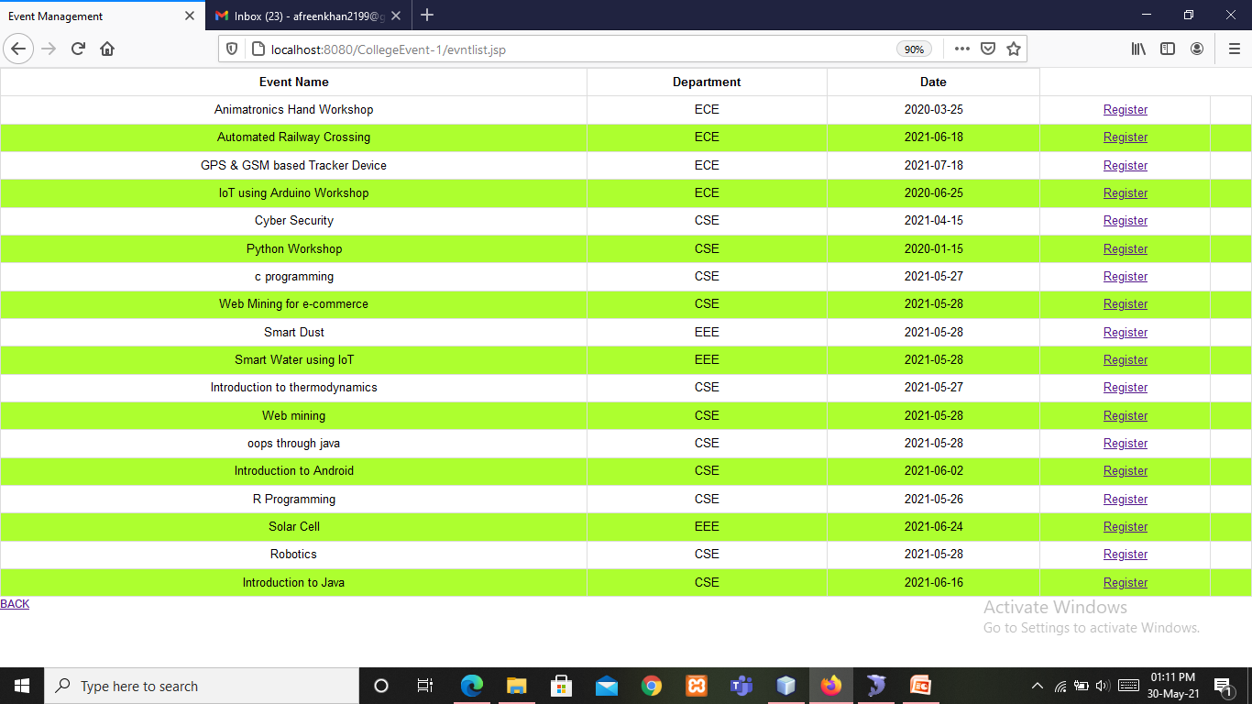

Slide 11
References
M. Ashok Kumar; College Activity Management System Second International Conference on Intelligent Computing and Control Systems (ICICCS) 2018.
Omkar Tiware, Prof. Kirti Rajadnya, Siddhesh Shinde College Activity Management International Research Journal of Engineering and Technology (IRJET) 2018.
BVRIT HYDERABAD College of Engineering for Women

Slide 12
Thankyou
BVRIT HYDERABAD College of Engineering for Women

